Slide 1
Topic: Census and Surveys EQ: What are the different types of Sampling Methods?
Put new topic in contents page
- Collect EST content list

Slide 2
Learning Intentions
Start of EST CONTENT
Students will be able to
Census
3.4.1 investigate the procedure for conducting a census
3.4.2 investigate the advantages and disadvantages of conducting a census
Surveys
3.4.3 understand the purpose of sampling to provide an estimate of population values when a census is not used
3.4.4 investigate the different kinds of samples, for example, systematic samples, self‐selected samples, simple random samples
3.4.5 recognise the advantages and disadvantages of these kinds of samples; for example, comparing simple random samples with self‐selected samples

Slide 3
24
7
30
Census and Surveys
Date
EQ – What are the different types of Sampling Methods?
Collecting Information
To collect information, a group of people are surveyed. This process is called taking a sample.
To collect information about a whole population, all people are surveyed. This is called a census.
Every 5 years the Australian Bureau of Statistics conducts a census. It occurs in each year ending with a 1 or a 6.
http://www.censusdata.abs.gov.au/census_services/getproduct/census/2016/quickstat/5?opendocument

Slide 4
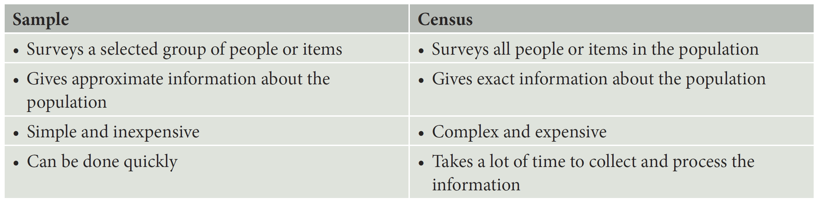
24
7
30
Census and Surveys
Date
EQ – What are the different types of Sampling Methods?
Sample Vs Census
Pros and cons

Slide 5
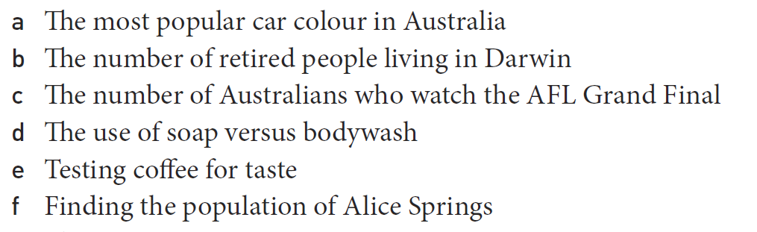
Practice
a. Sample
b. Census
c. Sample
d. Sample
e. Sample
f. Census

Slide 6


Slide 7
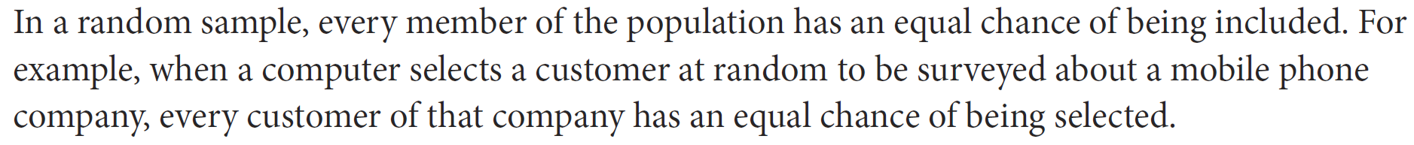
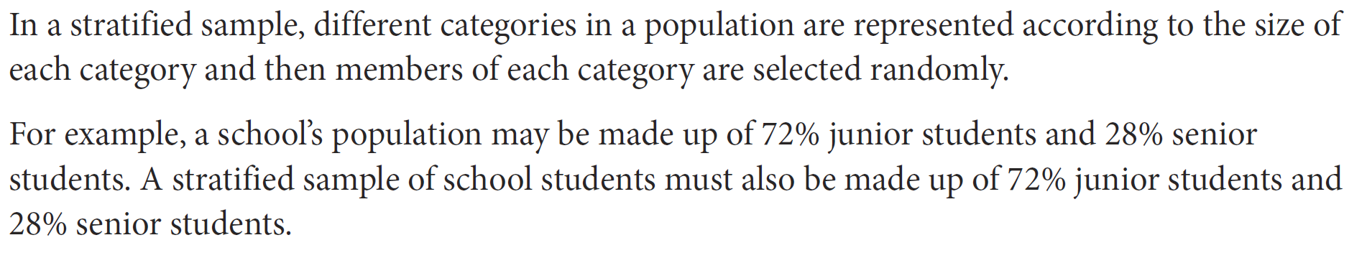
24
7
30
Census and Surveys
Date
EQ – What are the different types of Sampling Methods?
Random Sample
Stratified Sample

Slide 8
24
7
30
Census and Surveys
Date
EQ – What are the different types of Sampling Methods?
Systematic Sample
Self Selected Sample

Slide 9
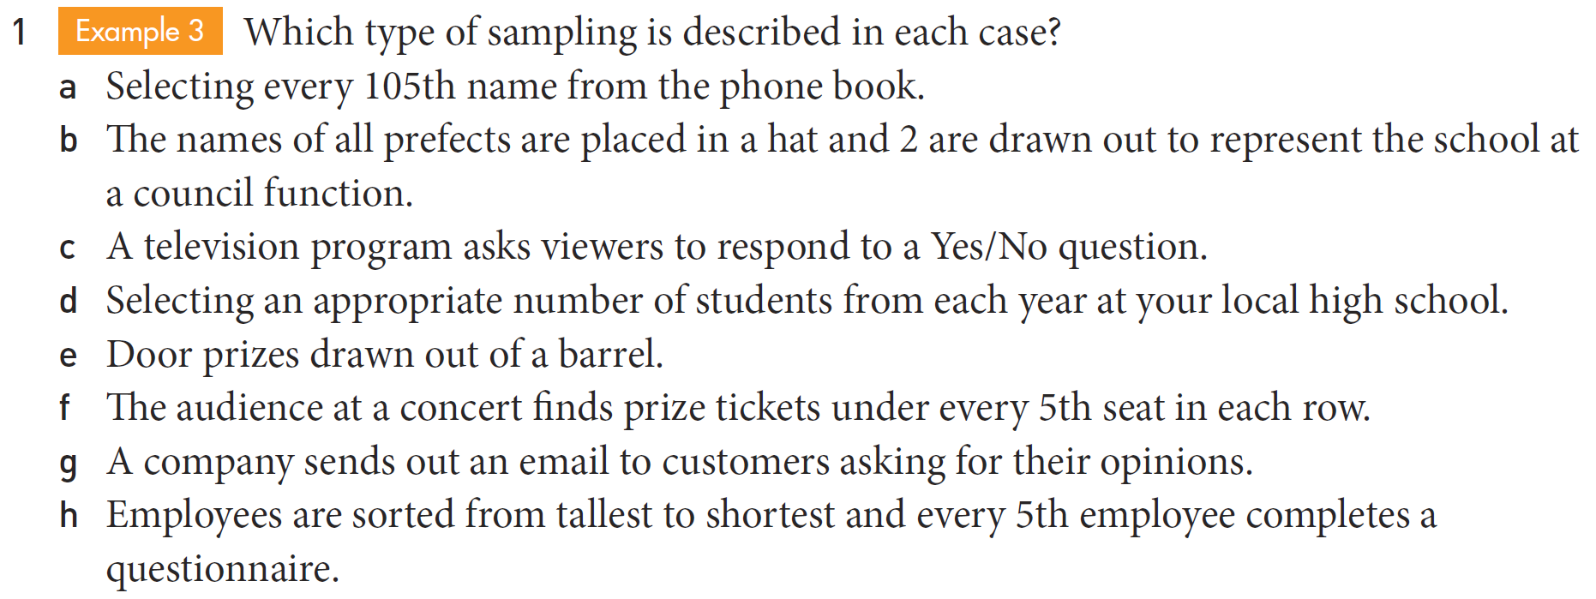
Practice
a. Systematic b. random c. self-selected d. stratified e. random f. systematic
g. self-selected h. systematic

Slide 10
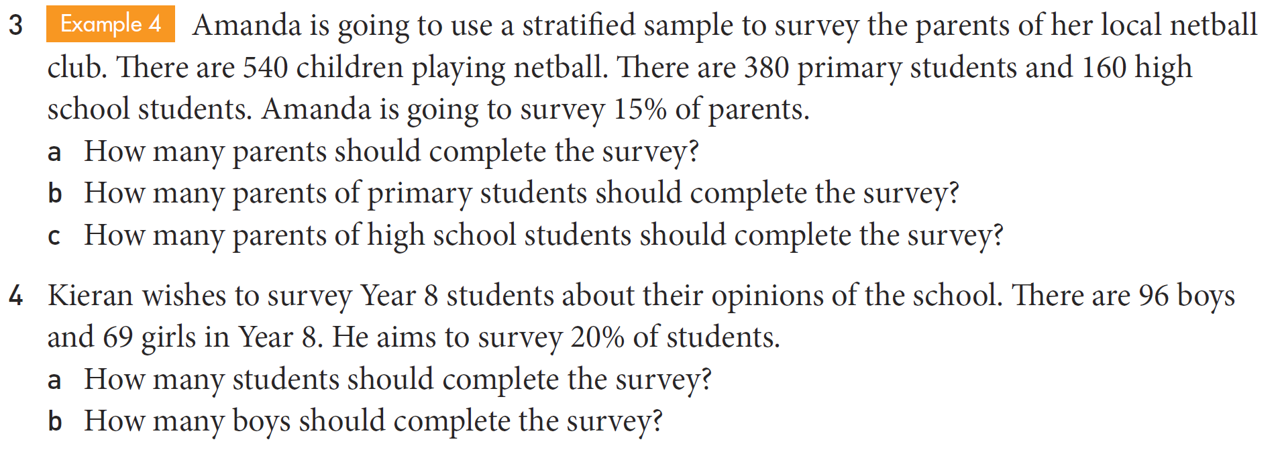
Task

Slide 11
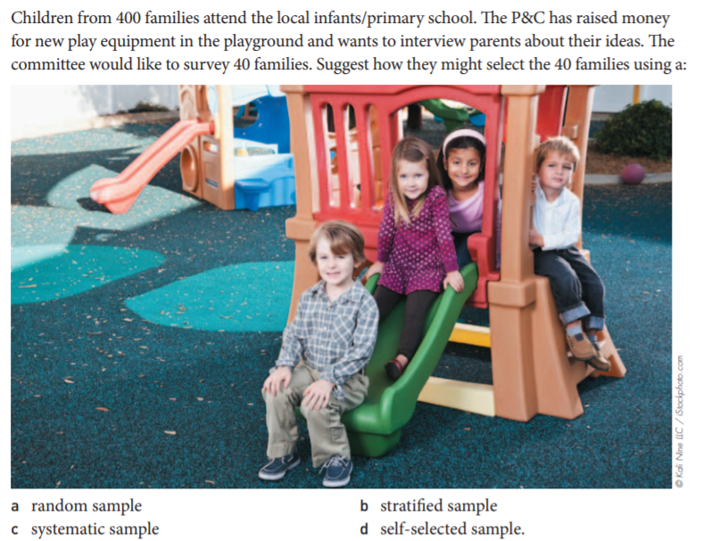
EXIT PASS- in pairs with butcher’s paper

